Slide 1
Understanding
Articles of faith
Presented by,
Syed Aslam

Slide 2
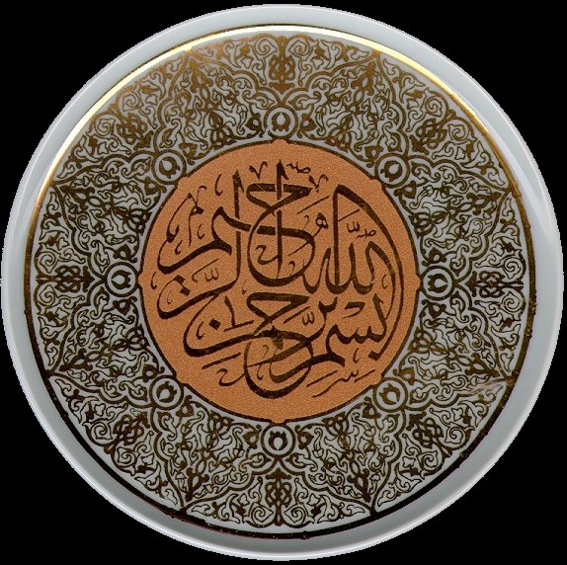

Slide 3
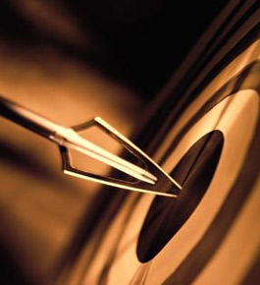
Faith
What is faith??

Slide 4
To believe in someone because of his authority
To trust someone
Its like if the water is stored in the root of a rock that is not affected by the disasters outside.

Slide 5
Importance of faith

Slide 6
What are the articles of faith?

Slide 7
Belief in
Allah
His angels
His books
His Messengers
the last day
predestination and decree
Resurrection

Slide 8
Belief in the Oneness
Does God Exist?
Share a video to show Allahs Powers
System and the harmony of the universe
Creation of life and death
“I recognized my Lord with the in accomplishment of my intentions” Hazrat Ali (ra)
Is He One??

Slide 9
Belief in the Oneness
He is one :
In His person
In His attributes
In His worship

Slide 10
Belief in the Oneness
He is :
Omnipotent
Omniscient
Omnipresent

Slide 11
Belief in angels
Angels are the servants of God.
They are made of light
Their sole purpose is to worship, obey and serve God.
Jibril (a.s) took messages to prophets, he also took God’s message to Bibi Maryam.
Mikaal (a.s) is responsible for carrying out the system of universe, Izrail (a.s) is the angel of death and Israfil (a.s) will sound the trumpet on the last day, Kiraman katibeen record good and bad deeds; Munkir Nakir inquire of the dead in the grave
They are not the daughter of Allah

Slide 12
Belief in angels
They don’t have the free will
They don’t have any gender
They are free of human weaknesses
They don’t have the generation system
They don’t disobey Allah
They have the analytical skills
They were sent to help the Muslims in Badr
They are to represent the symbol of Allah’s majesty

Slide 13
Belief in Books
Sent for the guidance of mankind
All were from Allah
The messages was common
All were brought by Jibrail (a.s)
The new books were sent when (i) the older books were lost (ii) changed (iii) Allah wanted to bring a change as per the need of the people
The revelation of the new book cancelled the previous book

Slide 14
Belief in Books
Difference between a book and a scripture
Four Books and their Prophets names
The Taurat Hazrat Musa (a.s)
The Zabur (Psalms) Hazrat Dawood (a.s)
The Injil Hazrat Isa (a.s)
The Holy Quran Prophet Muhammad (saw)
Quran is the final Book
It encompasses the teaching of all earlier books

Slide 15
Belief in Books
Quran is unchanged
Its a universal Book
It’s the guidance for entire humanity
It has not doubt in it
Its teaching are eternal
Its challenges have not been met so far
It is as majestic as Allah is Himself
Its in a living language
Allah has promised to guard it

Slide 16
Belief in Prophets
Need of a Prophet when books is there?
Chosen slaves of Allah
Sent for the guidance of mankind
Being the role model
Spiritual guide
To explain the wisdom
Usually sent from among them
Physically normal human beings
High level of spirituality
No blood relation with God

Slide 17
Belief in Prophets
Some were given miracles
About 124000 were sent
Muslims are supposed to believe and respect them all but cant follow them.
Prophet Muhammad (saww) was the last of them all.
Finality of Prophet Muhammad (saww)
“…. I am the last brick to it”
The demand of believing him as the last

Slide 18
Life after Death
One day every thing shall perish
Allah knows when it will come.
Everything shall come to an end by the blow of angel in trumpet
Allah will resurrect them all for account in Arafat
That will be a day of panic and disaster
Balance of deeds will be raised to weigh deeds
A narrow passage will be established over hell
Good will be given accounts sheet in right hand
Allah will bring witnesses if anybody refuses
Good people will go to Heaven bad to hell
Prophets, martyrs, Huffaz, scholar and good deeds will intercede for bad Muslims
Bad Muslims will be sent Paradise after punished

Slide 19
Predestination and decree
What do you believe about it?
Why reward and punishment?
The true concept of this belief.

Slide 21

Thank you

